Slide 1

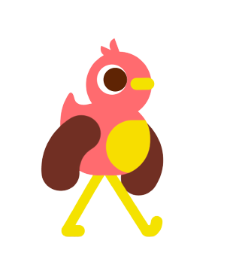
REFRESHMENT GAME
GROUP 3

Slide 2






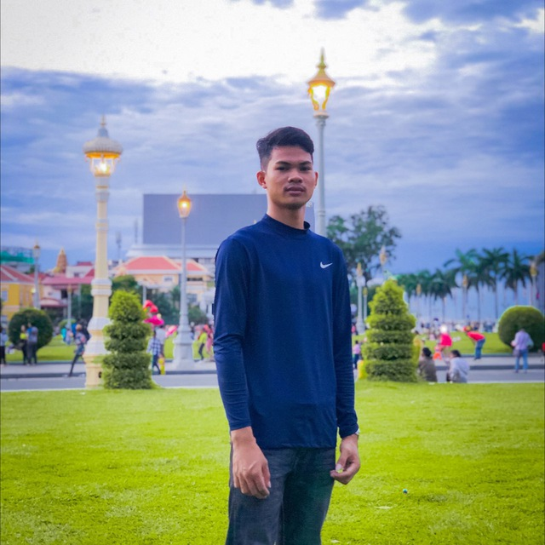





Member Group 3
NONG PHLOEUT
VIREAK ROEUN
SELLER
Tech

Slide 3

GAME OBJECTIVE
Chickens need to eat fruit.
it needs to eat fruits to get energy
If it eats fast food it will lose energy.
SELLER
NONG PHLOEUT

Slide 4
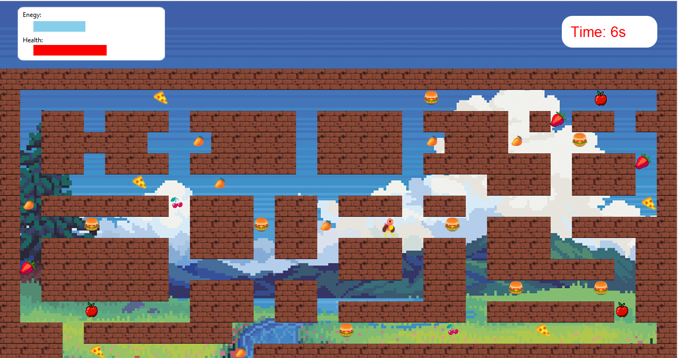
Timer
GAME PLAY
Energy
Heath
Character Use the key move up down left right
SELLER
NONG PHLOEUT

Slide 5
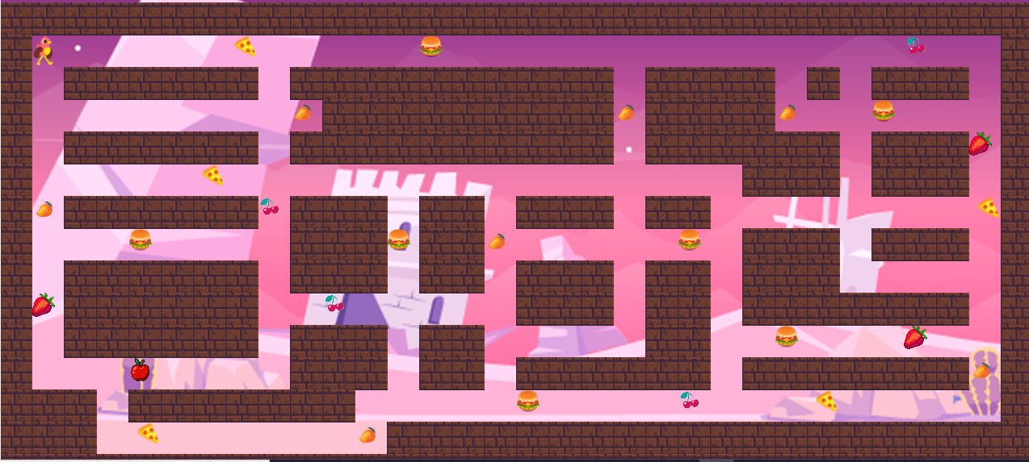
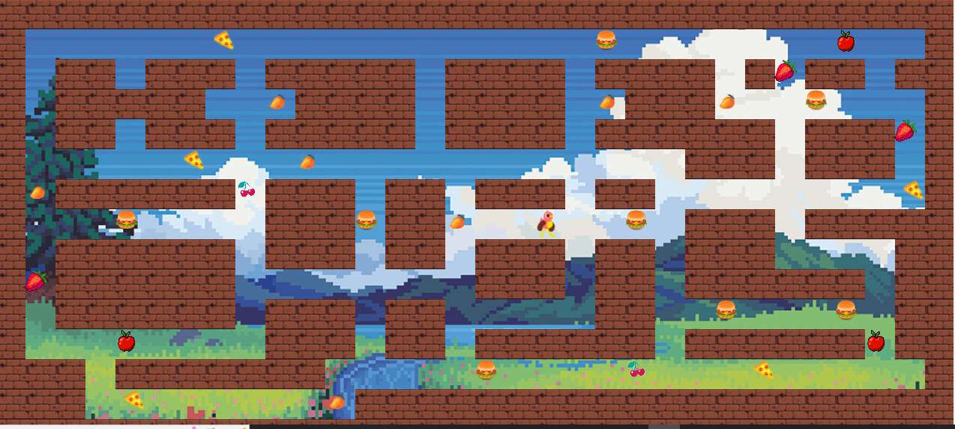
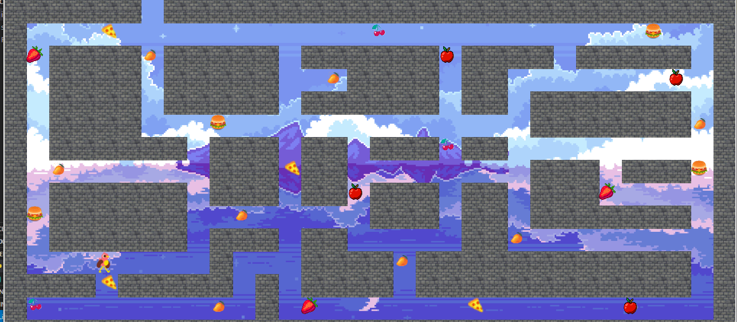
GAME PROGRESSION
LEVEL 1
LEVEL 2
LEVEL 3
SELLER
NONG PHLOEUT

Slide 6
WHAT DO WE LEARN ?
know about healthy food and unhealthy food
Improved cognitive abilities.
More flexible
SELLER
NONG PHLOEUT

Slide 7
GAME DEMO
SELLER
NONG PHLOEUT

Slide 8

DATA STRUCTURE
Static items
levelGrid=[
[0, 0, 0, 0, 0, 0, 0, 0, 0 ,0 ,0 ,0 ,0 ,0 ,0 ,0 ,0 ,0 ,0 ,0 ,0 ,0 ,0 ,0 ,0 ,0 ,0 ,0 ,0 ,0 ,0 ,0],
[0, 2, 1, 1, 1, 1, 1, 6, 1 ,1 ,1 ,1 ,1 ,5 ,1 ,1 ,1 ,1 ,1 ,1 ,1 ,1 ,1 ,1 ,1 ,1 ,1 ,1 ,8 ,1 ,1 ,0],
[0, 1, 0, 0, 0, 0, 0, 0, 1 ,0 ,0 ,0 ,0 ,0 ,0 ,0 ,0 ,0 ,0 ,1 ,0 ,0 ,0 ,0 ,1 ,0 ,1 ,0 ,0 ,0 ,1 ,0],
[0, 1, 1, 1, 1, 1, 1, 1, 1 ,3 ,0 ,0 ,0 ,0 ,0 ,0 ,0 ,0 ,0 ,3 ,0 ,0 ,0 ,0 ,3 ,1 ,1 ,5 ,1 ,1 ,1 ,0],
[0, 1, 0, 0, 0, 0, 0, 0, 1 ,0 ,0 ,0 ,0 ,0 ,0 ,0 ,0 ,0 ,0 ,1 ,0 ,0 ,0 ,0 ,0 ,0 ,1 ,0 ,0 ,0 ,10 ,0],
[0, 1, 1, 1, 1, 1, 6, 1, 1 ,1 ,1 ,1 ,1 ,1 ,1 ,1 ,1 ,1 ,1 ,1 ,1 ,1 ,1 ,0 ,0 ,0 ,1 ,0 ,0 ,0 ,1 ,0],
[0, 3, 0, 0, 0, 0, 0, 0, 8 ,0 ,0 ,0 ,1 ,0 ,0 ,1 ,0 ,0 ,0 ,1 ,0 ,0 ,1 ,1 ,1 ,1 ,1 ,1 ,1 ,1 ,6 ,0],
[0, 1, 1, 1, 5, 1, 1, 1, 1 ,0 ,0 ,0 ,5 ,0 ,0 ,3 ,1 ,1 ,1 ,1 ,1 ,5 ,1 ,0 ,0 ,0 ,1 ,0 ,0 ,0 ,1 ,0],
[0, 1, 0, 0, 0, 0, 0, 0, 1 ,0 ,0 ,0 ,1 ,0 ,0 ,1 ,0 ,0 ,0 ,1 ,0 ,0 ,1 ,0 ,0 ,0 ,1 ,1 ,1 ,1 ,1 ,0],
[0, 10, 0, 0, 0, 0, 0, 0, 1 ,1 ,8 ,1 ,1 ,1 ,1 ,1 ,0 ,0 ,0 ,1 ,0 ,0 ,1 ,0 ,0 ,0 ,0 ,0 ,0 ,0 ,1 ,0],
[0, 1, 0, 0, 0, 0, 0, 0, 1 ,0 ,0 ,0 ,1 ,0 ,0 ,1 ,1 ,1 ,1 ,1 ,0 ,0 ,1 ,1 ,5 ,1 ,1 ,1 ,10 ,1 ,1 ,0],
[0, 1, 1, 1, 15, 1, 1, 1, 1 ,0 ,0 ,0 ,1 ,0 ,0 ,1 ,0 ,0 ,0 ,0 ,0 ,0 ,1 ,0 ,0 ,0 ,0 ,0 ,0 ,0 ,3 ,0],
[0, 0, 0, 1, 0, 0, 0, 0, 0 ,0 ,0 ,1 ,1 ,1 ,1 ,1 ,5 ,1 ,1 ,1 ,1 ,8 ,1 ,1 ,1 ,6 ,1 ,1 ,1 ,1 ,1 ,0],
[0, 0, 0, 1, 6, 1, 1, 1, 1 ,1 ,1 ,3 ,0 ,0 ,0 ,0 ,0 ,0 ,0 ,0 ,0 ,0 ,0 ,0 ,0 ,0 ,0 ,0 ,0 ,0 ,0 ,0],
[0, 0, 0, 0, 0, 0, 0, 0, 0 ,0 ,0 ,0 ,0 ,0 ,0 ,0 ,0 ,0 ,0 ,0 ,0 ,0 ,0 ,0 ,0 ,0 ,0 ,0 ,0 ,0 ,0 ,0],
]
TECH
Vireak Roeun

Slide 9
DATA STRUCTURE
Fruit items
Fruit =
[
{
type: apple,
position: anywhere,}
]
Fruit =
[
{
type: burger,
position: anywhere,}
]
Fruit =
[
{
type: mango,
position: anywhere,}
]
Fruit =
[
{
type: chery,
position: anywhere,}
]
TECH
Vireak Roeun

Slide 10
DATA STRUCTURE
Chicken data
Chicken=
[
{
position: anywhere,
Energy:40/100,
Heath: 60/100}
]
TECH
Vireak Roeun

Slide 11
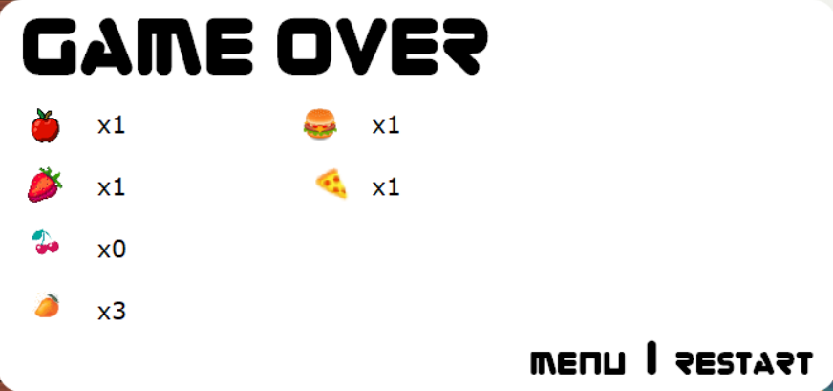
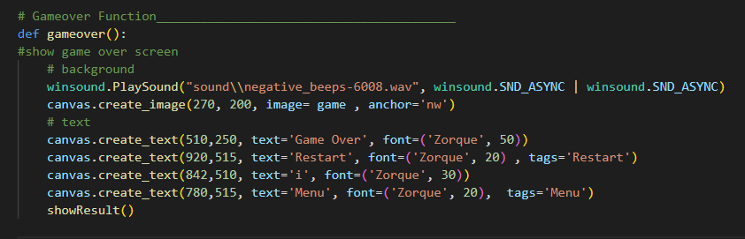
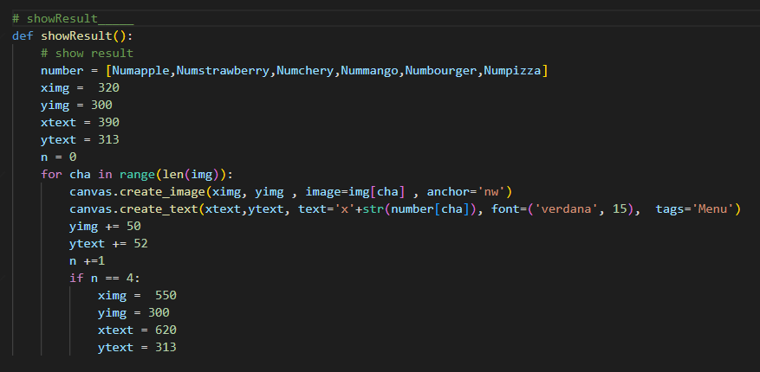
FEATURE 1
TECH
Vireak Roeun

Slide 12
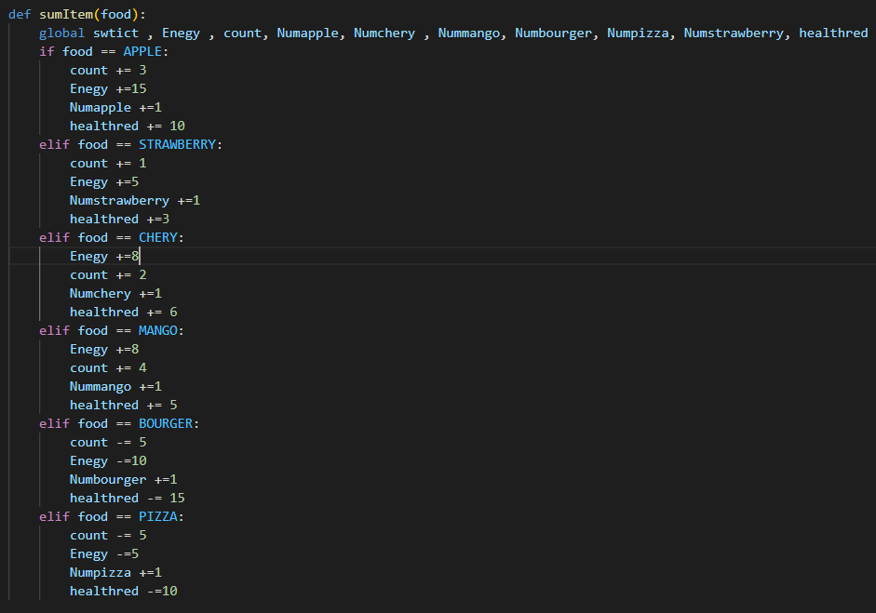
FEATURE 1
TECH
Vireak Roeun

Slide 13
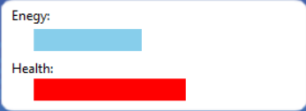
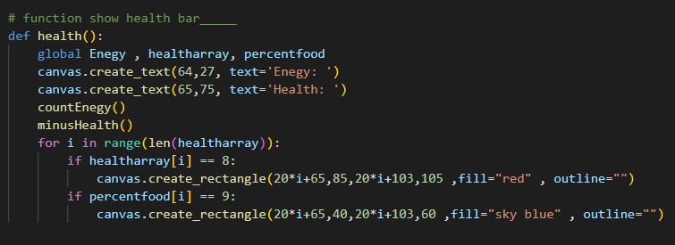
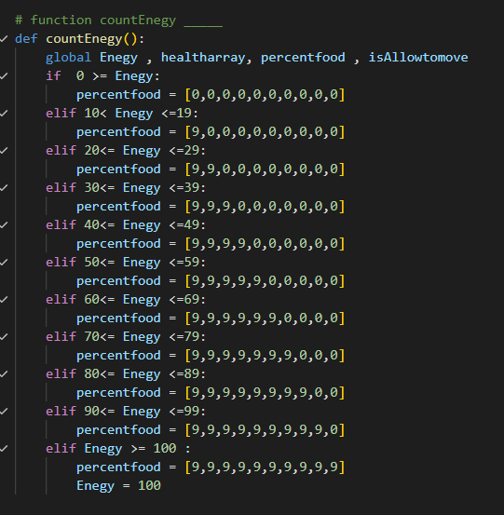
FEATURE 2
TECH
Vireak Roeun

Slide 14





T H A N K Y O U

